Slide 1
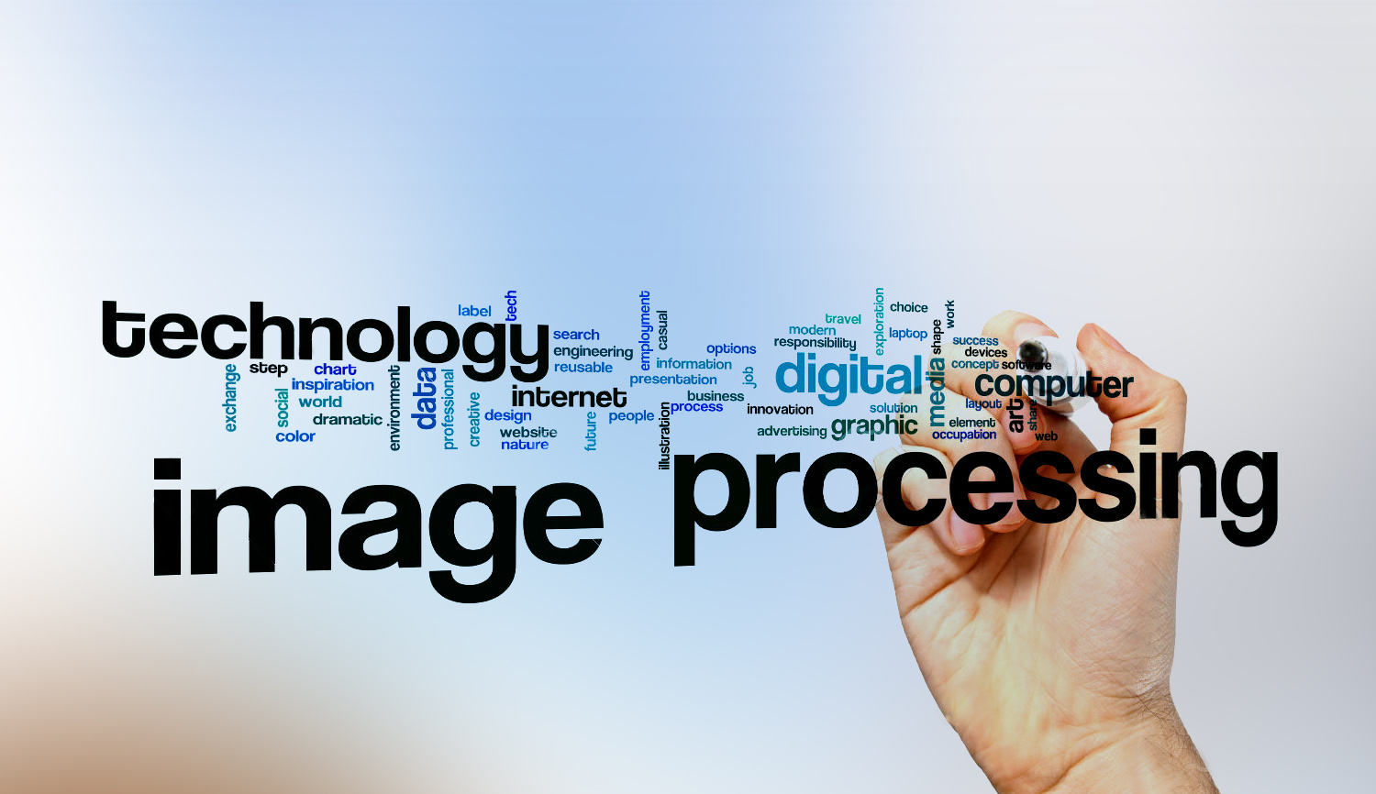
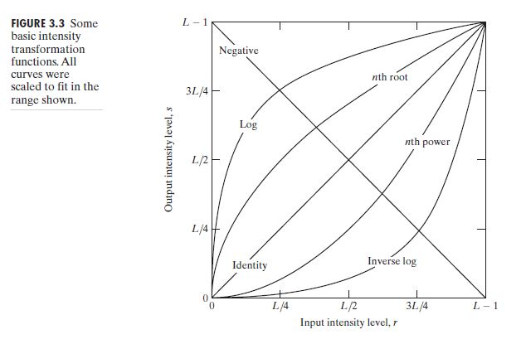

Digital Image Processing
18- Draw Log transformation.

Slide 2
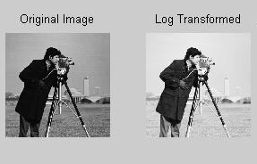
Digital Image Processing
18- Draw Log transformation.

